Slide 1
Lesson 11 – Homework review

Slide 2
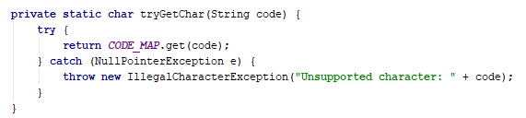
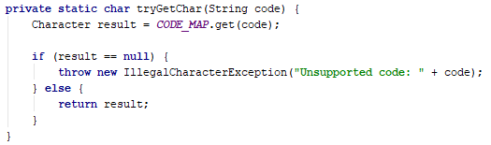
Do not catch NullPointerException

Slide 3
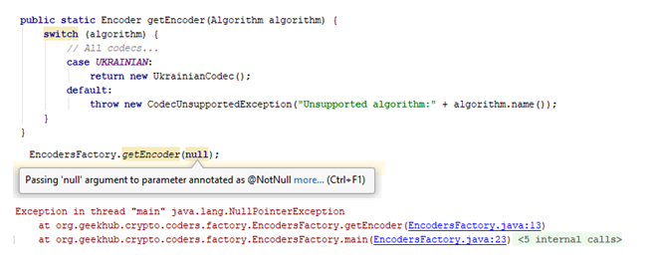
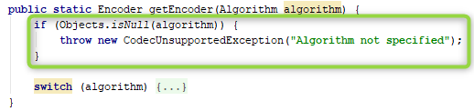
Prevent NullPointerException

Slide 4
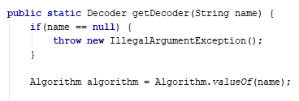
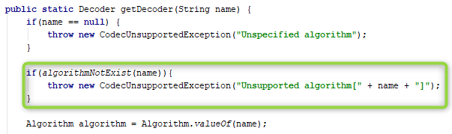
Prevent IllegalArgumentException

Slide 5
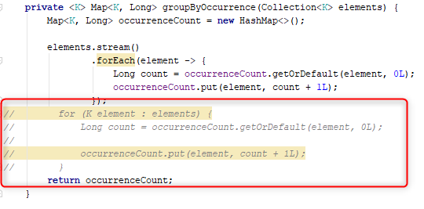
Do not commit useless code

Slide 6
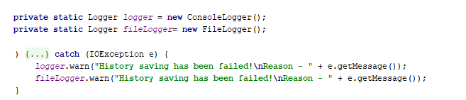
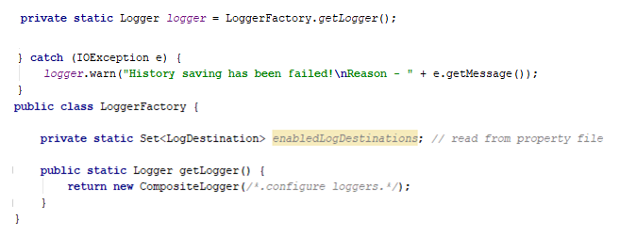
Do not Repeat Yourself

Slide 7
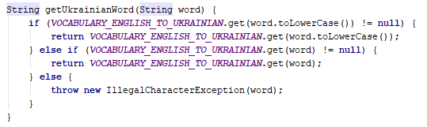
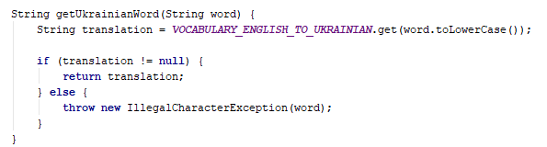
Inefficient map usage

Slide 8

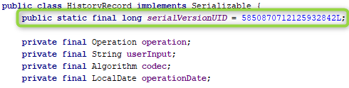
Missing serializable class version

Slide 9
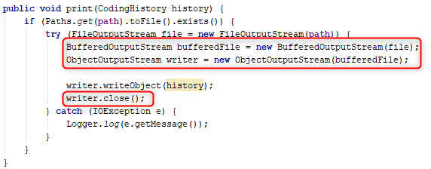
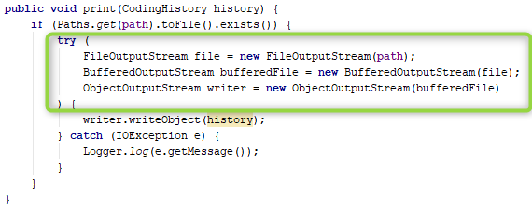
Close resources automatically

Slide 10

Persist History automatically

Slide 11
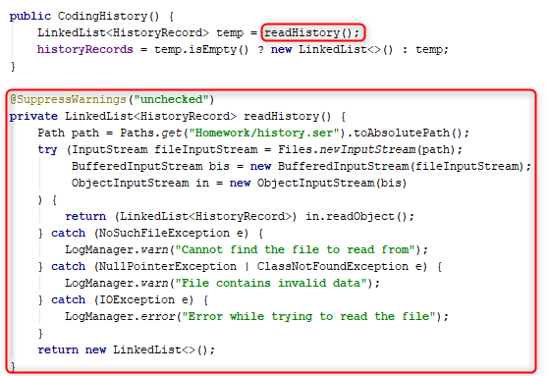
Lease coupling

Slide 12
Use non project-specific paths

Slide 13
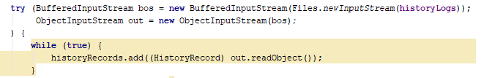
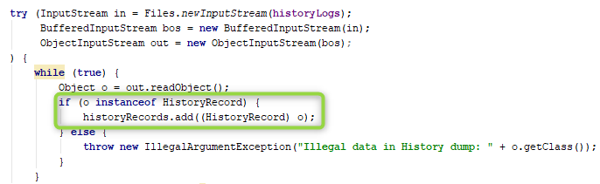
Check type before class cast

Slide 14
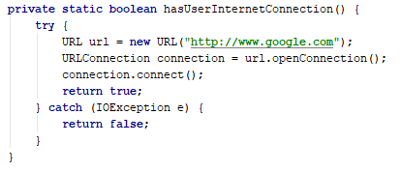
Be efficient

Slide 15

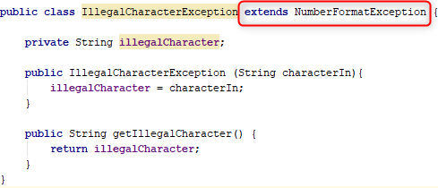
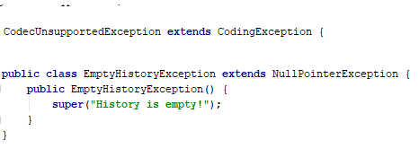
Incorrect exceptions hierarchy

Slide 16
Homework
Move all dictionaries to property files;
Decouple logging from UI;
Rename IllegalCharacterException to IllegalInputException;
Fix Null-checks;
Remove support of the next codecs:
VIGENER2X_HAS_A;
VIGENER2X_IS_A;
Fix class structure according to code convention;
Load list of enabled loggers from property file in csv format:
loggers=FILE,CONSOLE

Slide 17
Apply recommendations from personal feedbacks before starting next homework

